Slide 1
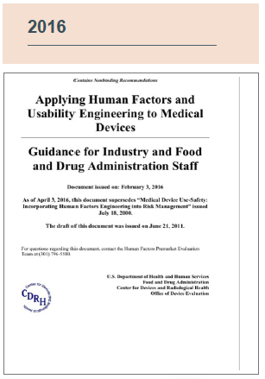
FDA Guidance: Applying Human Factors and Usability Engineering to Medical Devices
By: Mary Hazard

Slide 2

Agenda
Purpose of Guidance
History of FDA & Human Factors
Actual Document structure
HFE As Risk Management & Use Related Hazards
3 Steps to a HFE/UE Analysis for med devices
Device Classifications and FDA Applications

Slide 3
What is this guidance for?
Medical Devices must have approval from FDA before they can be sold in the US.
FDA Approval requires that the device has proven to be Safe & Effective
Proof that a device is safe & Effective -> through a Usability Analysis
“Applying Human Factors and Usability Engineering to Medical Devices”
Notes:
1. In order to market and sell a device in the US it must first be approved by FDA
2.For them to approve your device you must first prove to the FDA that it is SAFE and EFFECTIVE
Safe and Effective means: the device can be used without serious use errors or risk of harm to users.
3. To show this the manufacturers need to complete and submit HFE/Usability tests, which should provide evidence that risk has been identified and eliminated, or otherwise reduced to an acceptable level
4. Document: To simplify this process, and make it easier for manufacturers to check all the boxes they need to check, the FDA created this document which functions as a set of recommendations for how to complete HFE/Usability testing to identify and minimize error of use risks.
If you follow their recommendations then you are more likely to be able to show you have mitigated the risks to the FDA, then they will probably clear it and you can sell it.
Though this testing may also improve efficiency, ease of use, User experience. The FDA Mostly concerned with identifying and identifying risks resulting from use errors through HFE / Usability testing

Slide 4
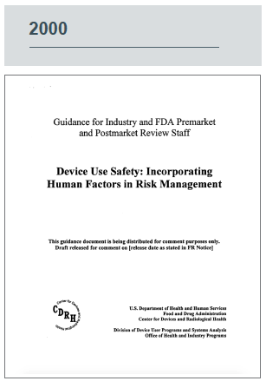
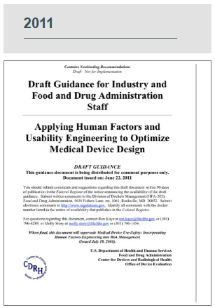
FDA & Human Factors History
Notes:
In 2000 the The FDA’s CRHD Center for Devices and Radiological Health released this guidance document describing how Human Factors should be incorporated into risk management
Over the next 10 years the Human Factors group was established within the FDA.
Over this time the demand on medical device manufacturers to provide evidence of HF processes in their Premarket Approval (PMA) applications grew from the FDA.
In 2011 the HF committee within the CDRH published the Human factors draft guidance which provided expectations for presenting evidence of adherence to a human factors process.
To many people in Medtech this represents the time that Human Factors became relevant to the regulatory process
5 years later in 2016 the FDA published its current guidance, which clarifies many of the steps manufacturers must complete when preparing their submission for pre market clearance in regards to a human factors.
that document is what I will be breaking down in my presentation today.

Slide 5
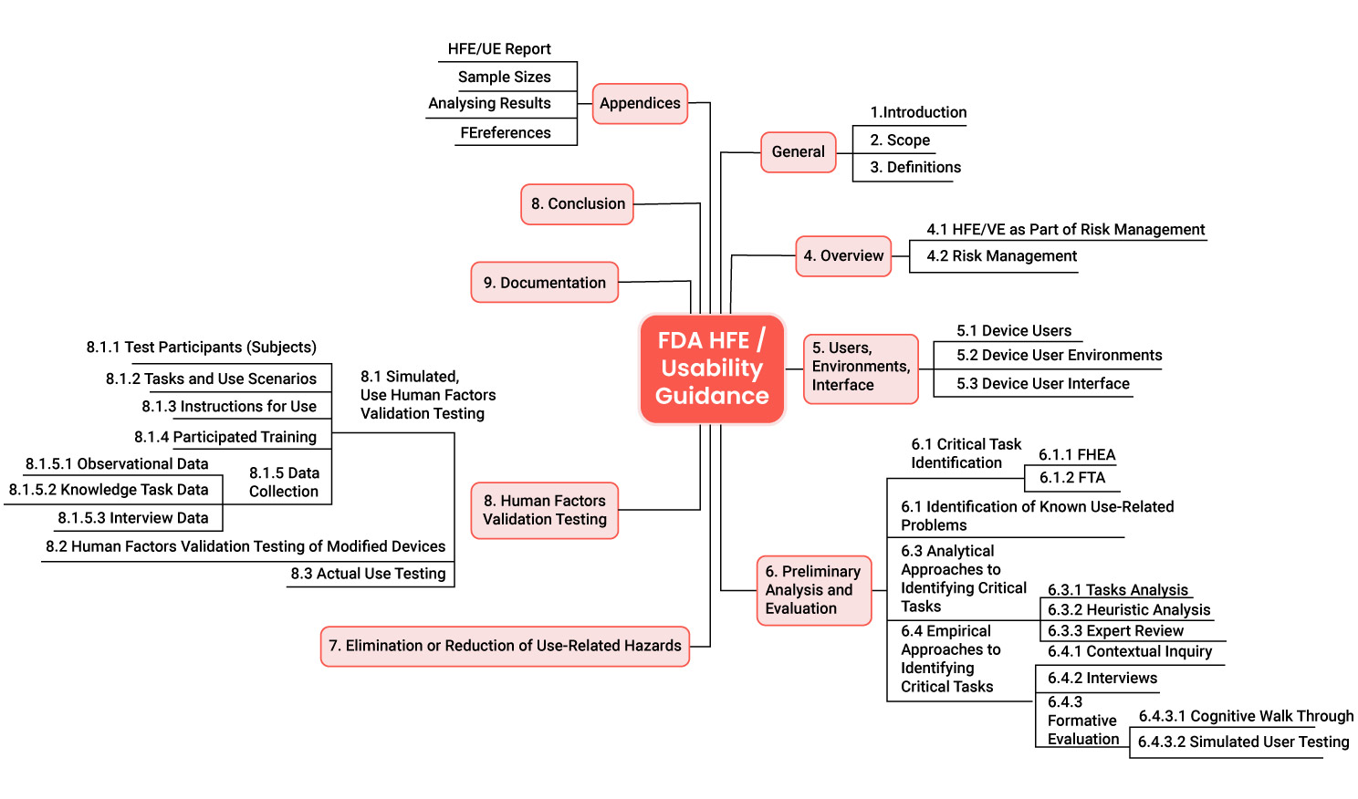
Document Structure
Notes:
So the document is divided up into 9 main sections and it is a total of 50 pages long
I will starting with section 4 which defines how HFE is used as risk mitigation
And remaining sections 5-9 outline how to conducting and HFE / UE Analysis
These include
HFE/UE As Risk Mitigation
Section 4
Steps to Conducting an HFE/UE Analysis
sections 5, 6, 7, 8, 9

Slide 6
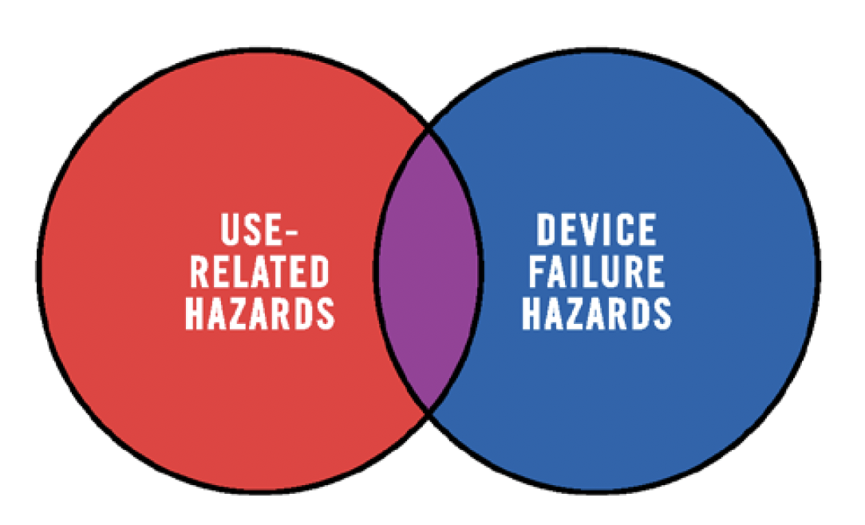
Types of Risk
Device related hazards
instances of device or component failure that are not dependent on how the user interacts with the device.
Sharp corners or edges
Electrical currents
Toxic chemicals
Use related hazards
Aspect of the design that may cause the user to fail to correctly perceive, read, interpret, understand, or act on information from the device.
HFE testing concerns
Notes:
There are 2 main types of risk that are considered in the overall risk management process.
Device Failure Hazards
Use-Related Hazards
Device related hazards = These hazards are generally associated with instances of device or component failure that are not dependent on how the user interacts with the device. Examples = Physical hazards (Sharp corners or edges) Electrical hazards - electrical currents, electromagnetic interference) Chemical hazards (toxic chemicals) etc.
Use Related Hazards = (Which are what HFE testing are mostly concerned with)
and what we are used to discussing

Slide 7
HFE / UE as Risk Management
Use-related hazards are related to one or more of the following situations:
Device use requires physical, perceptual, or cognitive abilities that exceed the abilities of the user;
Device use is inconsistent with the user’s expectations or intuition about device operation;
The use environment affects operation of the device and this effect is not recognized or understood by the user;
The particular use environment impairs the user’s physical, perceptual, or cognitive capabilities when using the device;
Devices are used in ways that the manufacturer could have anticipated but did not consider; or
Devices are used in ways that were anticipated but inappropriate (e.g., inappropriate user habits) and for which risk elimination or reduction could have been applied but was not.
Notes:
These are typically related to the user, use environment, and user interface.
Human Factors Engineering/ Usability Engineering is used to mitigate design-related problems that contribute to unsafe use.

Slide 8
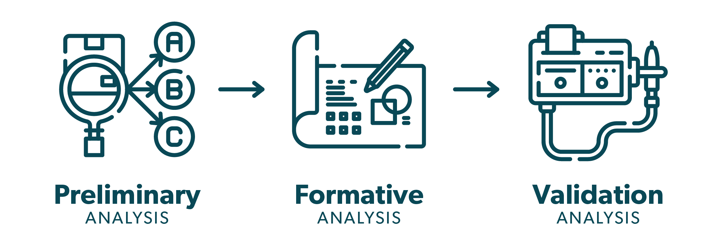
Steps to conducting an HF/UE Analysis
1
2
3
Aka Identify
Notes:
There are 3 differnte steps to actually conducting the HFE process
THese are slightly different than the document itself has three steps as well but groups the subcategories slightly differently.
But I watched a presentation that a research group did on this to non engineers and I think their explanation is easier to follow.
Step 1: Preliminary Analysis aka Identify & Document:
Device users,
User Environments,
And User Interface
Known Issues
Critical Tasks
Formative usability process
Identify use issues early in the design process before design is finalized and reiterate until risks are mitigated
Using Analytical and Empirical HF Methods
Mitigate risks with iterative design improvements.
Validate that your design is safe through Human Factors Validation testing

Slide 9


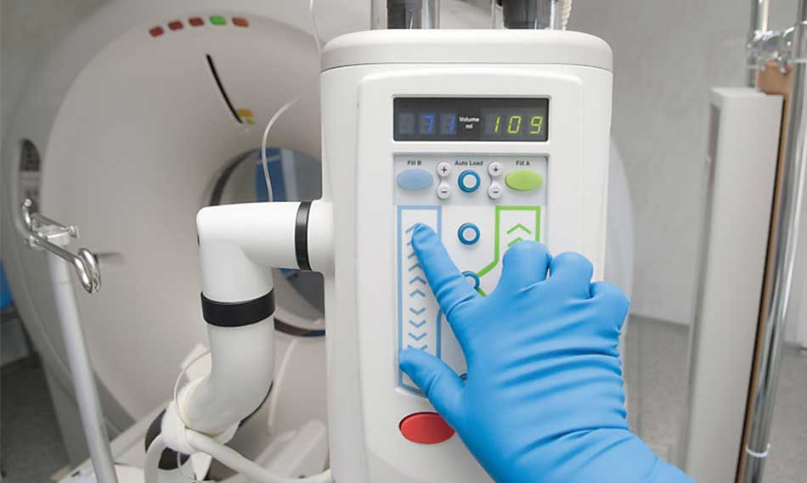
Step 1.1 Identify: Use Specification
1.1 Device Users
1.3 User interface
Packaging
1.2 Use Environments
Lighting
User groups: Who purchases the device, receives the device, unpacks the device, sets up the device, uses the device, cleans or reprocesses the device, disposes of the device
User Characteristics: Physical size, strength, stamina; Physical Limitations; Sensory and cognitive abilities; Medical conditions; Literacy and Language skills; Level of education and heal literacy; Mental & Emotional state of use; General knowledge of similar devices; Training.
Training
Instructions for Use (IFUs), Labeling
Graphical User Interface
Noise
Flooring
Temperature
Number of people in the environment
Amount of space users have
Notes:
3 main components make up use specification
Device Users: User Groups and User Characteristics
Use Environments:
User Interface”

Slide 10
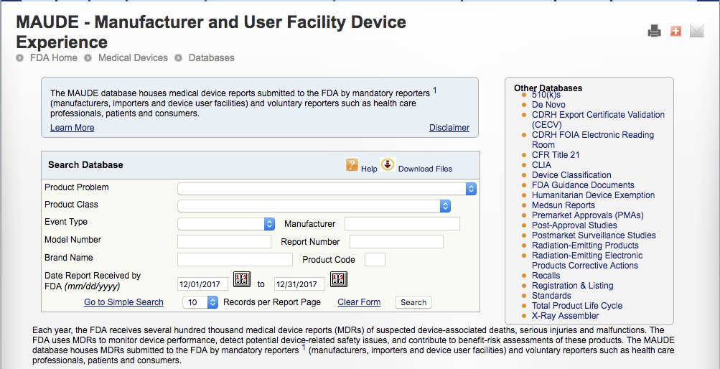
Step 1.2 Identify: Known Issues
Sources:
FDA’s Manufacturer and User Facility Device Experience (MAUDE) database
FDA’s MedSun: Medical Product Safety Network
CDRH Medical Device Recalls
FDA Safety Communications
ECRI’s Medical Device Safety Reports
The Institute of Safe Medical Practices (ISMP’s) Medication Safety Alert Newsletters
The Joint Commission’s Sentinel Events
Notes:
FDA’s Manufacturer and User Facility Device Experience (MAUDE) database
• FDA’s MedSun: Medical Product Safety Network
• CDRH Medical Device Recalls
• FDA Safety Communications
• ECRI’s Medical Device Safety Reports
• The Institute of Safe Medical Practices (ISMP’s) Medication Safety Alert Newsletters
• The Joint Commission’s Sentinel Events

Slide 11

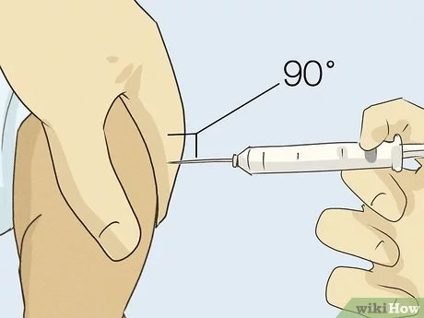
Step 1.3 Identify: Critical Tasks
Identify ALL Tasks associated with device use
Identify Critical Tasks
Critical tasks: Any task that if done incorrectly, or not performed at all could cause harm to the patient or user or result in a delay in therapy
Analytical HF Methods:
Task Analysis: set up, use, take down, storage etc.
User Failure Modes & Effects Analysis (uFMEA)
Fault Tree Analysis
Heuristic Analysis
Notes:
Often related to
Harm – to patient or user such as healthcare professional or caregiver
Dosing – dialing in dosage on pen auto injector
Administration – selecting the correct injection site
Urgency or time – epi pen or naloxone to reverse opioid overdose.
Mainly using analytical HF Methods at this point
Analytical Approaches
Task Analysis
User Risk Analysis
Fault Tree Analysis
Heuristic Analysis
Expert review

Slide 12
Step 2.1 Formative Usability Process
Evaluate interface elements in prototype forms
Early focus on “critical tasks”
Common Methods: Empirical
Interviews
Contextual Inquiry
Cognitive Walk Throughs / Think alouds
Simulated Use testing
Sample sizes
5-7 participants
Update
Task analysis, Critical tasks, Requirements
Iterate and retest
Notes:
Using mainly Empirical HF Approaches
Contextual Inquiry
Interviews/Focus Groups
Evals with prototypes
Cognitive Walk throughs /think aloud
Simulated Use testing
Iterative Design:
Update tasks, critical tasks, requirements -> iterate & retest
The Devices performance on critical tasks is ultimately what will determines its standing with the FDA

Slide 13
Step 2.2 Eliminate or Reduce Risks Using HF recommendations
1. Inherent safety by design
“Design out” risks and use errors
2. Protective measures in design”
Warnings
Alerts
Physical safeguards
3. Information:
User guides
Warning Labels
Training to avoid Error
Notes:
Once you reach the iterate and retest portion Goal here is to minimize risk to an acceptable level

Slide 14
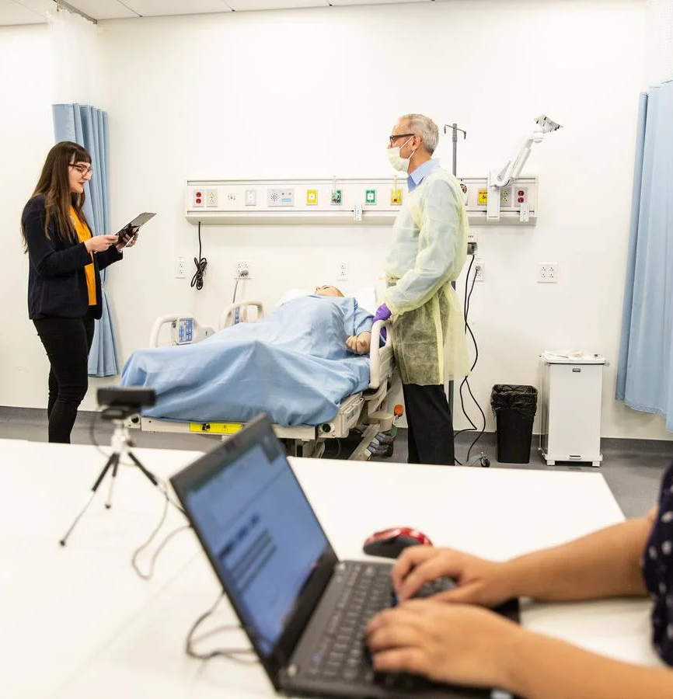
Step 3: HF Validation testing
Goal: Prove device is safe and Effective!
Characteristics
Final design of the device, IFUS, labeling
All interface elements made available
Sample size: 15 participants from EACH user group
Tests all critical tasks
Realistic simulated use scenarios
No leading the participants
Notes:
Safe and effective - Demonstrate device can be used without serious use errors
Validate findings through Human Factors Validation Testing
Also known as Summative testing - with final design
The human factors validation testing should be designed as follows:
The test participants represent the intended (actual) users of the device.
All critical tasks are performed during the test.
The device user interface represents the final design.
The test conditions are sufficiently realistic to represent actual conditions of use
Typically conducted under simulated use or in some cases, actual use.
To be considered optimized for safe and effective use:
the human factors validation test results should show no use errors or problems that could result in serious harm and that could be eliminated or reduced through modification of the design of the user interface, using one or more of the measures listed in Section 7. The realism and completeness of the human factors validation testing should support
Use 3 types of data
Observational
Knowledge task data (interviews) - test
Interview data

Slide 15
Review: Steps 1-3 conducting an HF/UE Analysis
1
2
3
Aka Identify
Notes:
To review there are 3 main steps to conducting a HFE/ UE analysis
Step 1: Preliminary Analysis aka Identify
Device users,
User Environments,
And User Interface
Known Issues
Critical Tasks
Formative usability process
Identify use issues early in the design process before design is finalized and reiterate until risks are mitigated
Usability testing with Empirical HF Methods
Mitigate risks with iterative design improvements.
Validate that your design is safe through Human Factors Validation testing
Data must show use errors on critical tasks has been eliminated
or risk has been reduced to acceptable levels

Slide 16
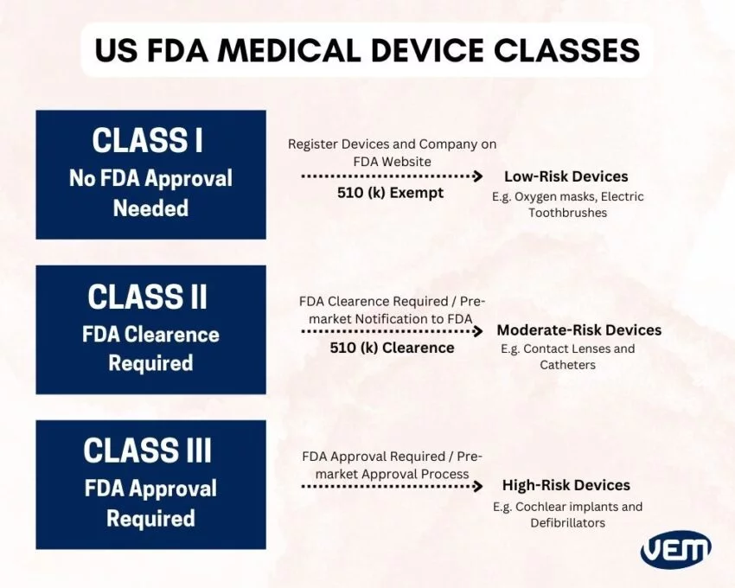
Final Steps
HFE Documentation
HF Validation Report
Submit Pre Market applications to FDA
Class I (501k exempt)
Class II (501k)
Class III (PMA)
Notes:
- HFE Documentation & Application write up
This process itself can be iterative – you can communicate with your FDA rep during the HF process to increase odds that you will be approved.
Different Classes of Devices Require different applications and levels
Determined by risk levels
Class I:
low risk devices: Oxygen masks, electric toothbrushes, gloves
501k exempt (exempt from HF testing)
Still Must register device and company on FDA website
Class II:
Moderate risk devices: catheters, injections
501k premarket application required (needs HF testing)
Can receive FDA Clearance
Class III:
High risk devices: Coclear implants, defibrillators
Pre market Application (PMA) required
Also require clinical trials
Less than 10% of med devices are classified as class III by FDA
Can receive FDA Approval

Slide 17
Questions?
Thank you!

Slide 18
Thank you!

Slide 20
References

Slide 21
Step 2.2 Eliminate or Reduce Risks HF recommendations
Inherent safety by design
“Design out” risks and use errors
Protective measures in design”
Warnings
Alerts
Physical safeguards
Information:
User guides
Warning Labels
Training to avoid Error
Notes:
Common strategies
Designing them out - inherent safety by design
Protective measures in the device
Shielded elements, warning screens, alerts
Information for safety
Warning Labels
Training to avoid error
There is always some residual risk. You just have to show that you designed out all that was possible and took reasonable steps to mitigate the rest.

Slide 22
Common HF Approaches

Slide 23
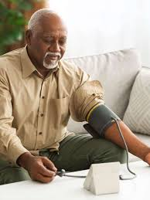

Step 1.1: Identify Device Users
Helpful questions to ask when identifying user groups:
Who purchases the device
Who receives the device
Who unpacks the device
Who sets up the device
Who uses the device
Who cleans or reprocesses the device
Who disposes of the device
Charateristics:
Physical size, strength, stamina
Physical Limitations
Sensory and cognitive abilities
Medical conditions
Literacy and Language skills
Level of education and heal literacy
Mental & Emotional state of use
General knowledge of similar devices
Notes:
Identify user groups
Characteristics of each user group

Slide 24
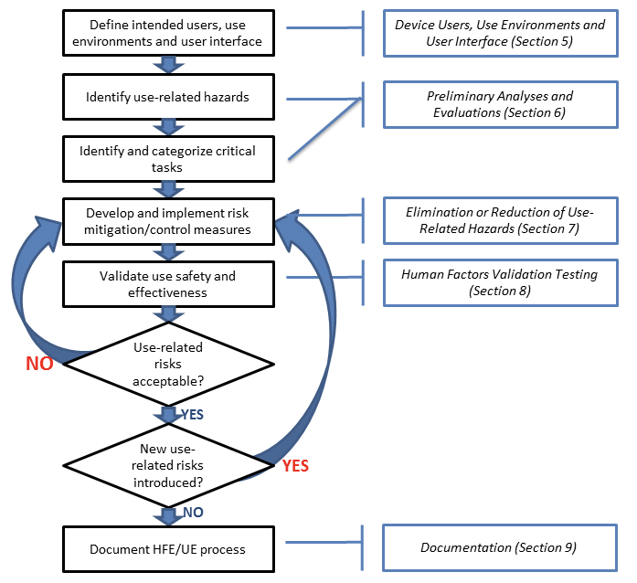
Steps to HFE/UE Analysis Sections 5-9
3 main steps
Identify: device users, user interface components, use environment, known issues, and critical tasks
(sections 5 &6)
2. Develop and apply measures to eliminate or reduce use related hazards (Section 7)
3. Human Factors Validation Testing: demonstrate whether the final device design supports safe and effective use. (Section 8)
Notes:
This figure depictsdepicts the risk management process for addressing use-related hazards;
Through HFE/UE Analysis

Slide 25
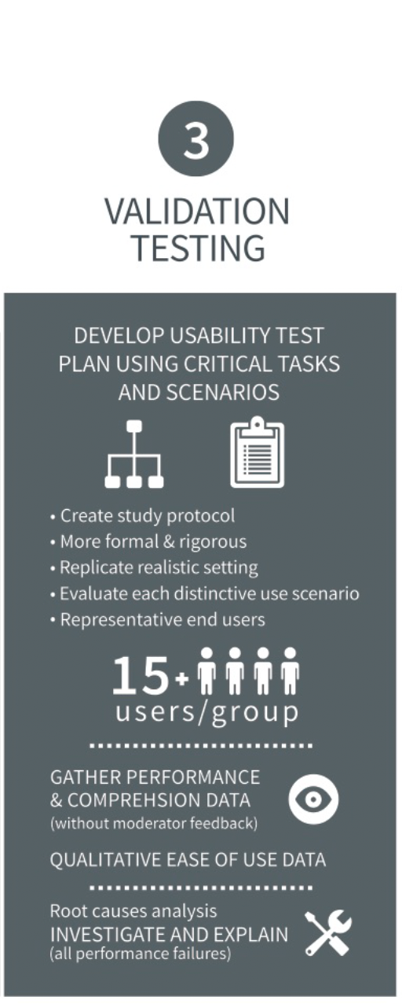
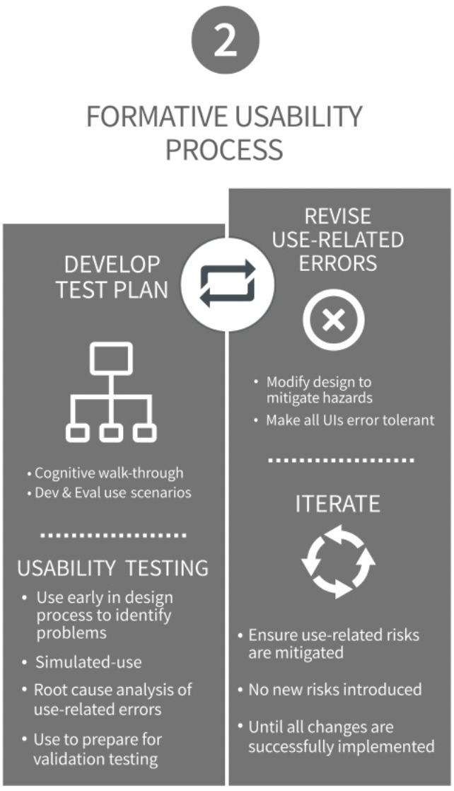
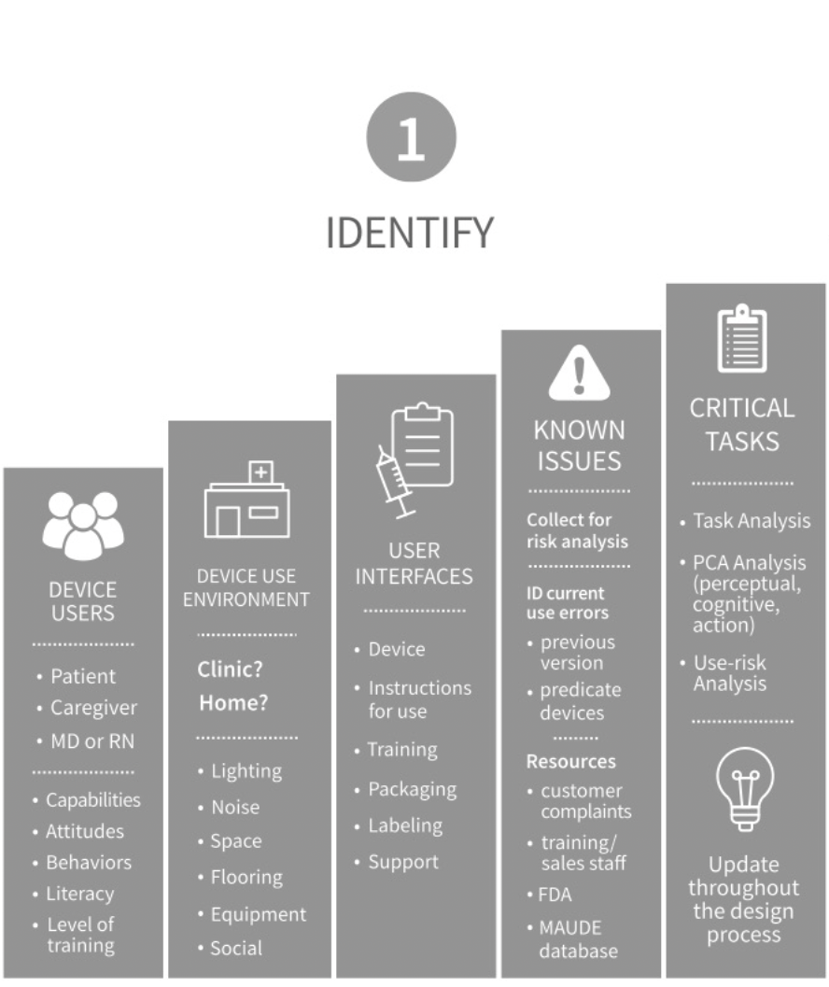
Steps to HF/UE Analysis
Notes:
The document itself has three steps as well but groups the subcategories slightly differently. But I watched a presentation that a research group did on this to non engineers and I think their explanation is easier to follow.
Step 1: Identify & Document:
Device users,
User Environments,
And User Interface
Known Issues
Critical Tasks
Formative usability process
Identify use issues early in the design process before design is finalized and reiterate until risks are mitigated
Using Analytical and Empirical HF Methods
Mitigate risks with iterative design improvements.
Validate that your design is safe through Human Factors Validation testing

Slide 26


Slide 27
Preliminary Analyses & Evaluations
Critical Task Identification:
Task Analysis
User Failure Modes Effects Analysis (uFMEA)
Refine task analysis through uFMEA
A team brainstorm with specialists from relevant areas.
Fault Tree Analysis (FTA)
Design & Execute Formative Evaluations
Notes:
One of the most important outcomes of
these analyses is comprehensive identification and categorization of user tasks, leading to
a list of critical task
Critical Tasks: A user task which, if performed incorrectly or not performed at all, would or could cause
serious harm to the patient or user, where harm is defined to include compromised
medical care.
The following methods are used to identify and categorize use related hazards, but the results shuld be used to inform plans for simulated use. That can confirm the findinhs of
Analysis Methods
Task analysis
Risk analysis methods
uFMEA
Refine task analysis through uFMEA
A team brainstorm with specialists from relevant area
The team brainstorms possible use scenarios that could lead to “failure mode” and considers the tasks and potential harm for each possible use error

Slide 28
Section 4: HFE / UE as Risk Mitigation
Human Factors Engineering/ Usability Engineering is used to mitigate design-related problems that contribute to unsafe use.
Use-related hazards are related to one or more of the following situations:
Device use requires physical, perceptual, or cognitive abilities that exceed the abilities of the user;
Device use is inconsistent with the user’s expectations or intuition about device operation;
The use environment affects operation of the device and this effect is not recognized or understood by the user;
The particular use environment impairs the user’s physical, perceptual, or cognitive capabilities when using the device;
Devices are used in ways that the manufacturer could have anticipated but did not consider; or
Devices are used in ways that were anticipated but inappropriate (e.g., inappropriate user habits) and for which risk elimination or reduction could have been applied but was not.

